Slide 1

Department of ECE
ANALOG ELECTRONIC CIRCUIT DESIGN 22EC2104A
CO-2
Session-2 Characteristics: pinch-off voltage, drain saturation current

Slide 2






AIM OF THE SESSION
To familiarize students with the Characteristics: pinch-off voltage, drain saturation current
of the Junction Field effect Transistor
INSTRUCTIONAL OBJECTIVES
This Session is designed to:
Give introduction of JFET Drain characteristics
Transfer characteristics.
LEARNING OUTCOMES
At the end of this session, you should be able to:
Describe characteristics of JFET
Analyze the drain and transfer characteristics of JFET.

Slide 3
INTRODUCTION
The drain characteristic of a JFET illustrates the relationship between the drain current (I_{D}) and the drain-source voltage (V_{DS}), while keeping the gate-source voltage (V_{GS}) constant.
In the active region, where VGS is below the pinch-off voltage (Vp), the drain current ID increases linearly with V_{DS}. This indicates that the JFET operates as a voltage-controlled resistor in this region.
As V_{DS} increases, the channel between the drain and source becomes wider, allowing more current to flow.
However, once V_{DS} reaches a certain level, saturation occurs, and the drain current reaches a maximum value, known as the saturation current (I_{DSS}).
In saturation, the JFET acts as a current-controlled current source, and further increases in V_{DS} do not affect the drain current significantly

Slide 4
Cont..
The transfer characteristic of a JFET shows the relationship between the drain current (I_{D}) and the gate-source voltage (V_{GS}) while maintaining a constant V_{DS}.
In the cutoff region, where V_{GS} is less than Vp, the JFET is non-conductive, and I_{D} is almost zero.
As V_{GS} increases beyond Vp, the JFET enters the ohmic region, where I_{D} rises rapidly with a slight increase in V_{GS}.
This region demonstrates that the JFET operates as a voltage-controlled resistor. However, as V_{GS} continues to increase, the JFET eventually enters the saturation region, where the drain current remains relatively constant despite further increases in V_{GS}.

Slide 5
Cont..
The transconductance (g_{m}) of the JFET is the measure of how much the drain current changes for a given change in gate-source voltage and is an important parameter for amplification purposes.

Slide 6
CHARACTERISTICS OF JFET
The characteristics of JFET are defined by a plotting a curve between the drain current and drain-source voltage.
The variation of drain current with respect to the voltage applied at drain-source terminals keeping the gate-source voltage constant are termed as its characteristics.
Basically, the characteristics are of two types that are output characteristics or drain characteristics, and the another is transfer characteristics.
In the first case the output characteristics are observed when there is no bias, i.e. there is no voltage applied between gate and source terminals.
Another condition is that the biasing is applied between gate and source terminals. In both the condition the variation of drain current is different.

Slide 7
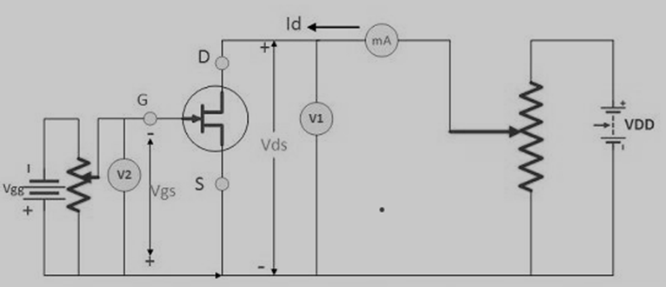
Output characteristics or drain characteristics
In the absence of external bias: In this case, as there is no voltage between gate and source terminal, thus, the drain current will flow from drain terminal to source terminal.
From the working of JFET that majority charge carriers flow from source to drain and as a consequence of which the current flows from drain to source.
It clearly implies that the channel width is more as the width of depletion layer will not vary initially because there is no external reverse biasing.

Slide 9
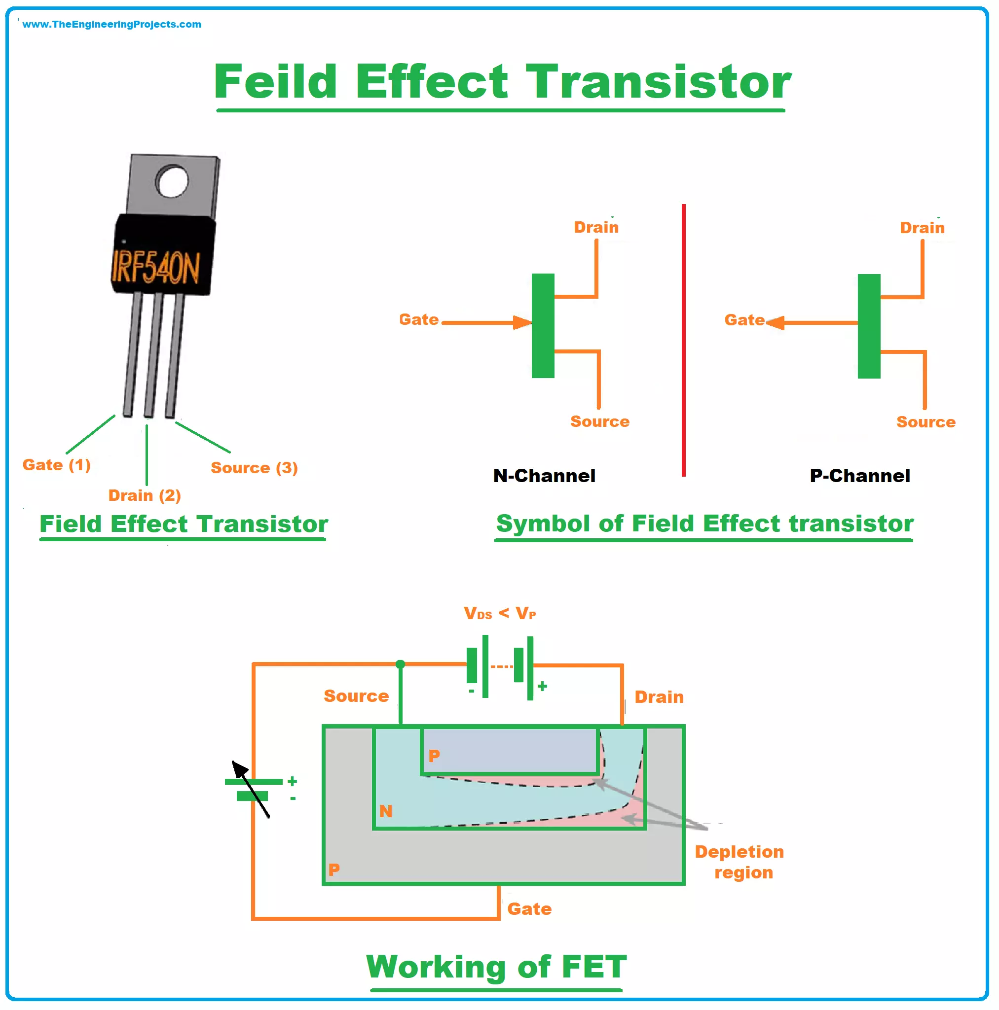
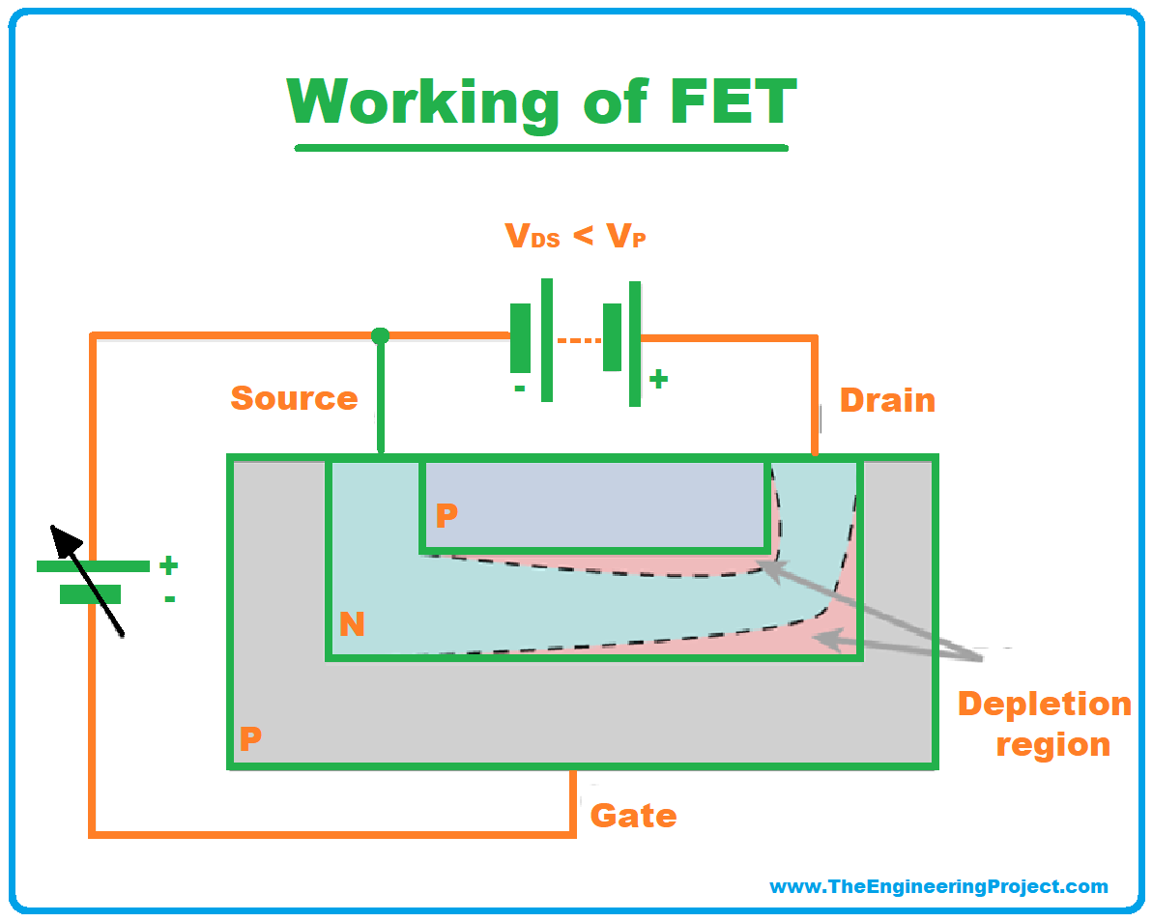

Slide 10
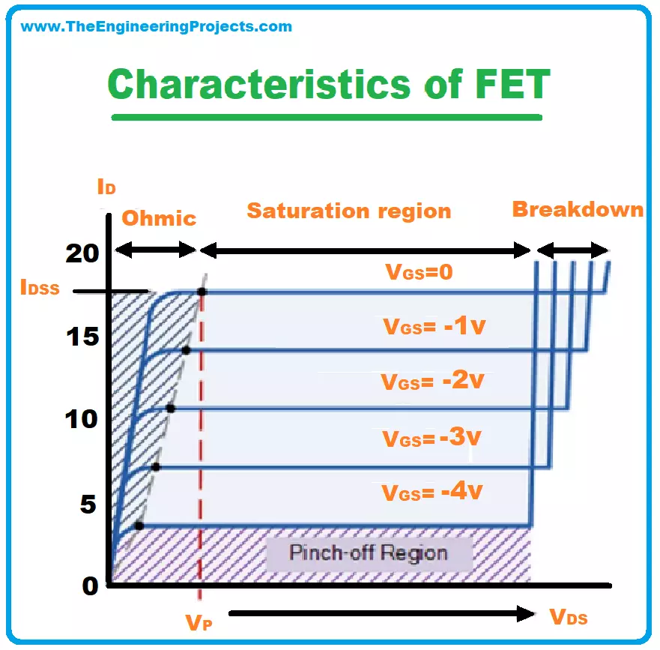
Breakdown Mechanism
At high VDS​, the reverse-biased gate–channel junction (pn junction) experiences very large electric field.
When this field exceeds a critical value:
Avalanche Breakdown occurs → electrons gain enough energy to knock off other electrons → multiplication effect.
This causes a sudden, sharp increase in ID​ even though VGS​ is fixed.

Slide 11
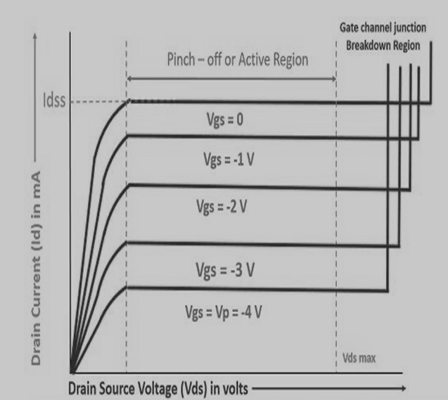
Cont..
This allows a large magnitude of current to flow through the channel.
In this case, the N-type channel will simply behave as resistance region.
The flow of current from drain to source will create the voltage drop between gate and source. This will eventually result in reverse biasing of the gate-source terminal.
The reverse biasing will be more towards drain region that source region.

Slide 12
Terminologies involved in JFET characteristics
Knee Point: There exists a point in the characteristics curve where the variation of drain current with drain-source voltage appears to be linear. But after this point, the linearity changes into a curve.
Channel Ohmic Region: The region to the left of the knee point in the characteristics curve is the channel ohmic region.
Pinch-off point: The point in the curve above which the drain current does not increases further no matter how much we are increasing the drain to source voltage, this point is termed as the pinch-off point.

Slide 13
Cont..
Pinch-off Voltage: The voltage at the pinch-off point is termed as pinch-off voltage because at this voltage the current is completely turned to be constant.
Drain-Source Saturation Current: The drain to source saturation current is the current which becomes constant or completely enters a saturation state.
The region after the pinch-off point in the curve is termed as saturation region. When the JFET is allowed to work as an amplification device, the JFET utilizes this region for operation.

Slide 14
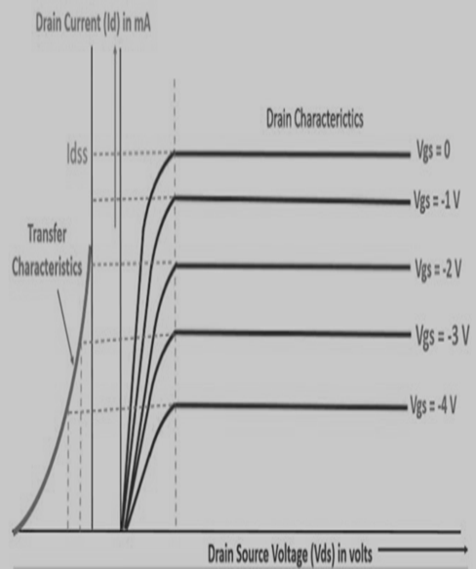
Transfer characteristics
The transfer characteristics can be determined by observing different values of drain current with variation in gate-source voltage provided that the drain-source voltage should be constant.
The transfer characteristics are just opposite to drain characteristics. One just needs to remember the concept that in drain characteristics
we are keeping the gate-source voltage constant and determining the values of drain current at different values of drain-source voltage while in transfer characteristics we are keeping the value of drain-source voltage constant.
The characteristic curve of transfer characteristics of JFET is described below; it can be easily observed that the value of drain current varies inversely with respect to gate-source voltage when the drain-source voltage is constant.

Slide 15

SUMMARY
The junction field-effect transistor (JFET) is a three-terminal semiconductor device with a unique voltage-controlled current flow.
Its drain characteristics describe the relationship between the drain current (ID) and drain-to-source voltage (VDS) when the gate-to-source voltage (VGS) is constant.
The drain current remains relatively constant as VDS increases until it reaches a saturation point.
The transfer characteristics of the JFET illustrate the relationship between the drain current and the gate-to-source voltage when VDS is held constant.

Slide 16
SELF-ASSESSMENT QUESTIONS
1. In a JFET, the channel conductivity is controlled by:
a) Gate-to-source voltage
b) Drain-to-source voltage
c) Gate-to-drain voltage
d) Gate-to-channel voltage
2. The output characteristic curve of a JFET shows the relationship between:
a) Drain current and drain-to-source voltage
b) Drain current and gate-to-source voltage
c) Drain current and drain-to-gate voltage
d) Gate current and gate-to-source voltage

Slide 17
TERMINAL QUESTIONS
1. With neat sketch explain the drain characteristics of n-channel JFET
2. Write short notes on transfer characteristics of JFET

Slide 18
REFERENCES FOR FURTHER LEARNING OF THE SESSION
Reference Books:
1. Jacob Millman - “Electronic Devices and Circuits”, 4th Edition, McGraw Hill Education (2015)
2. D Roy Choudhury and Shail B. Jain – “Linear Integrated Circuits”, 4th Edition, New Age International Pvt.Ltd. (2017)
3. David A. Bell - “Electronic Devices and Circuits”, 5th Edition, Oxford University Press (2008)
Sites and Web links:
https://www.learnelectronicswithme.com/2020/07/what-is-jfet-construction-and-working.html
https://electronicspost.com/explain-the-construction-and-working-of-a-jfet-what-is-the-difference-between-a-jfet-and-a-bjt/
https://electronicsdesk.com/junction-field-effect-transistor.html

Slide 19
THANK YOU
Team – ANALOG ELECTRONIC DEVICES AND CIRCUITS

